Slide 1


Adolescence Overview
Review
Regression
New male behaviours
New female behaviours
Management
Breeding assessment
What is assessed
Health tests to be done
Factors that help determine how breeders are picked

Slide 2

Review
Hormonal changes in puppy can cause them to be less obedient, as puppy is not able to control their impulses
Puppy may become more energetic and more interested in interacting with other dogs
Puppy may show fear or stress in situations they did not previously
Puppy may get frustrated easily when they do not get what they want, which will result in poor behaviours
Sleep patterns may change
Puppy may become destructive with items

Slide 3
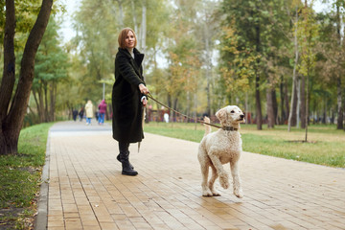
Regression
Puppy has low focus
Puppy has selective hearing
Puppy forgets commands
Puppy thinks they are the boss
Puppy poor behaviours increase
Jumping up
Barking
Mouthing

Slide 4

New male behaviours
Marking: lifting leg to urinate
Marking frequently on walks
Sniffing more
Showing interest in female dogs
Mounting
Higher energy level
Lower focus

Slide 5

New female behaviours
Heat cycle may cause
Puppy to mount
Puppy to clean themselves frequently
Puppy to be anxious
Puppy to nest
Showing interest in male dogs
Higher energy level
Lower focus

Slide 6

Management
Give puppy mental stimulation with short training exercises
Go back to basics for obedience
Keep sessions positive
Allow puppy to have an energy outlet
Longer walks in quieter areas
Play dates with familiar pups
Visit low distraction environments
Remove items puppy mounts or becomes destructive with

Slide 7

Breeding assessments
What is assessed
Health tests
Health check/history
Behavioural assessment
Obedience
Equipment acceptance
Ability to settle
Excitability/energy level
Loose leash walking
Handling
Kennel life compatibility
Environmental (i.e. stairs, bridges, traffic etc.)

Slide 8

Breeding assessments
Health tests to be done:
Hip x-rays
Elbow x-rays
Eye exam
Genetic panel

Slide 9

Breeding assessments
Factors that help determine how breeders are picked:
Health tests come back positive
No hip or elbow displaysia
No eye anomalies
No genetic issues
Health check/history comes back with no issues
No allergies (skin or stomach)
No chronic eye or ear infections
No history of impacted anal glands
No dental anomalies
Behavioural assessment shows puppy would be:
Comfortable with handling and medical tests (i.e. having blood taken)
Comfortable in kennel setting
Able to settle well
Good overall manner and demeanor

