Slide 1


Breaking Bad Habits Overview
Scavenging
Management
Training
Counter surfing
Management
Training
Distractions
Management
Training
Separation Anxiety
Management
Training

Slide 2
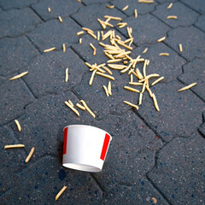
Scavenging: Management
Eating something off the ground is an instant reward, which reinforces the habit
Use distance to walk around spills or items on the ground
If puppy picks up something from the ground unexpectedly, remove item from puppies mouth then ask for a sit and reward puppy
If puppy picks up something harmful from the ground, make note of what it is and how much puppy ingested before you removed it from puppy’s mouth
Notify the vet clinic or emergency line
If puppy begins to play keep away with items as a game, try to get the item away using a high value treat for trade or throw kibble on the ground to get the item away
Begin to use a long line with puppy when they are outside to stop any keep away games

Slide 3
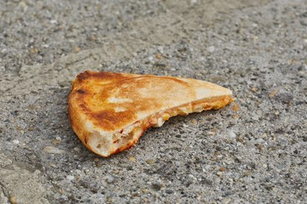
Scavenging: Training
Trade: teach puppy that when you take something from them, they get something in return of equal value (i.e. treat, kibble, toy etc.)
Leave it: teach puppy a ‘leave it’ cue that has puppy not approach the item on the ground
Practice a duration and food distraction wait
Build up with low value items
Set up practice sessions with objects on the ground​
Start far away with low value items​
On walks, treat puppy more frequently to keep their head up and focus on you rather than the ground
Be more vigilant on garbage days, as small animals can rip open garbage bags and create easy access to items

Slide 4
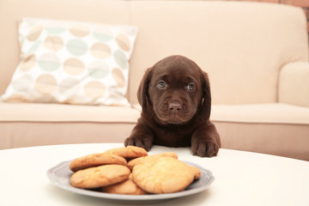
Counter Surfing: Management
Keep counters clear of any enticing objects​
Ensure food is put away or out of reach so puppy is never successful​
Use barriers to keep puppy out of the kitchen ​
Use baby gates, crate or x-pen​
If you need to leave, take puppy with you​ or crate puppy
Have puppy tethered to you or a secure object away from the counters​
Always supervise puppy around counters

Slide 5

Counter Surfing: Training
Mat: Teach puppy a “mat” cue, so they stay on the mat while in the kitchen​
Practice a duration “wait” on the mat​
Down-wait is the preferred position​
Release with an “ok”​
Interrupt puppy in the kitchen then reward puppy away from the counter to encourage them away​
Off: Teach puppy off by asking for an “off” before puppy has jumped up​
Set up practice sessions with objects on the counter​
Start far away with low value items​
If puppy jumps up, remove puppy and modify management techniques

Slide 6
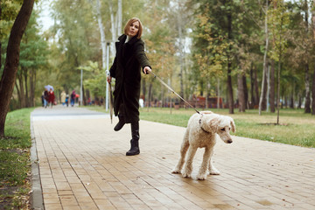
Distractions: Management
Be mindful of what triggers puppy to be distracted (i.e. other animals, dogs, people, kids etc.)
Also monitor puppy’s threshold of how much distance is needed between puppy and the distraction to get puppy’s attention back
Use distance as a way to put space between puppy and the distraction
Have a high value treat on hand to get puppy’s focus back
Treat puppy for eye contact in low distraction environments
If a distraction comes up unexpectedly, either do a u-turn and walk away in the direction you came from or move away from the distraction at an angle and walk by it quickly with high value treats on puppy’s nose
Try to remain calm and relaxed around the distraction, as puppy will feed off of your energy as well
Shorten leash while out on walks

Slide 7
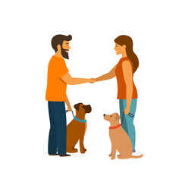
Distractions: Training
Duration wait: have pup in a sit in front of you, count a few seconds then reward and release with ‘ok’
Build up time for puppy in position
Distance wait: have pup in a sit in front of you, take one step away then back, then reward and release with ‘ok’
Build up steps away for puppy in position
Distraction wait: have pup in a sit in front of you, squeak a toy, then reward and release with ‘ok’
Build up with more distracting items
Greetings with people: have pup sit in front of you and reward pup while person pets pup from behind; if pup gets too excited then should end greeting
50/50 for greetings in or out of jacket
Greetings with dogs: walk up to dog with loose leash, allow 3 second sniff, call pup by name or use noises to get pup’s attention and walk away
Ensure pup only greets familiar dogs

Slide 8

Separation Anxiety: Management
Puppies become extremely attached to their caregiver, which can cause separation anxiety when the caregiver needs to leave puppy alone. Because our puppies can go out to social settings as dogs in training, they may be used to going out with their caregiver more often than staying home alone.
Contact puppy staff if you think puppy is showing signs of separation anxiety
Absence observation: try to record puppy after you leave so you can assess what puppy does when you leave
Observe body language: puppy may bark, howl, become destructive or scratch at their crate tray when you leave
Management of absence: to begin working on puppy’s confidence, only leave puppy alone when doing training sessions
Desensitization: it is a slow process to adapt puppy to being alone
Try to avoid a ‘mat’, ‘wait’ or ‘down’ command before you leave, as puppy will be ready to participate rather than rest

Slide 9
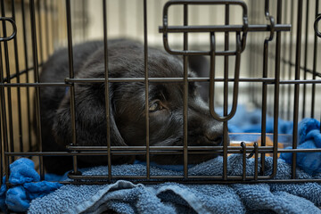
Separation Anxiety: Training
Use a high value treat that is only for training sessions for separation anxiety
When you put puppy in their crate avoid making a big deal out of leaving, but instead be calm and quiet
When you release puppy from their crate remain calm and quiet to keep puppy’s energy relaxed
Build up puppy’s confidence in their crate by crating puppy while you are also home
Ensure puppy’s crate does not have bedding if you think puppy will chew it in your absence
It is good to leave puppy home and crated a few times a week, so they are confident when they are alone

