Slide 1
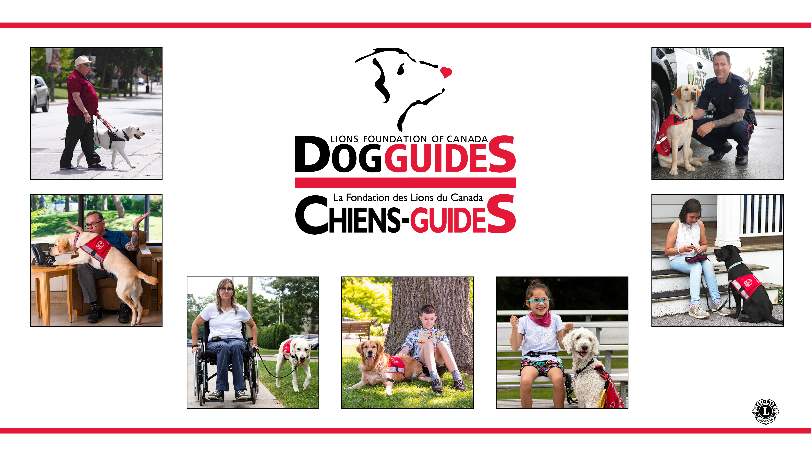

Slide 2

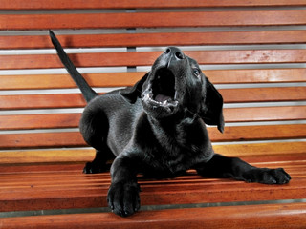
Barking
Barking
  Notes
  Types of barking
  Tips

Slide 3
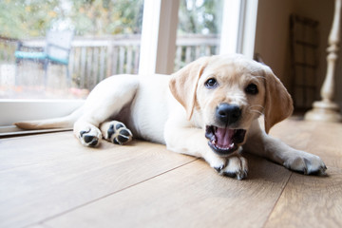
Barking: Notes
Barking is a very natural and normal form of expression for dogs
Depending on the type of bark, puppy may need different solutions
Puppies can learn to bark for as long as they need to in order to get what they want
A few barks are fine, but when barking is excessive, we need to see what is the issue
Dog Guides may be asked to use barking to communicate in their future service

Slide 4
Barking: Types of barking
Type of Bark | Meaning | What to do
Demand/ Frustration | Puppy is not getting what they want | Ignoring a barking dog is the best option, removing yourself or the dog from the room/area and should be used as often as possible. Once the barking has stopped, reward puppy for being quiet and give puppy something to do such as a sit, down, game or walk.
Crate/ Boredom | Puppy does not want to be in crate | Once you have interrupted the bark, reward for quiet and give them something to do such as a sit, down, game or walk.
Play/ Excitement | Puppy is having fun and letting everyone know | If puppy is barking during play or out of excitement, take puppy to a quiet spot and do a few minutes of eye contact exercises. Once puppy is calm, release puppy back to play. If puppy cannot perform the eye contact exercises, give them a few minutes in their crate to calm down.
Fear/Anxiety | Puppy is unsure and scared | If puppy is approaching someone or something while barking, turn and walk away far enough to stop the bark and then try to reapproach.
Panic/Alarm | Puppy is alerting you | Assess what puppy need i.e. bathroom break, then ask for a sit or down to refocus puppy.

Slide 5

Barking: Tips
Dogs cannot bark and sniff at the same time.
  Elicit quiet by holding a treat in front of your puppy’s nose
  Then praise for quiet
Always reward positive quiet and calm behaviours
  If puppy is in a situation that would normally trigger a bark and puppy does not bark, reward their quiet behaviour
Your puppy may be over stimulated and needs a nap
  Some quiet time in his crate is always a good answer

Slide 6
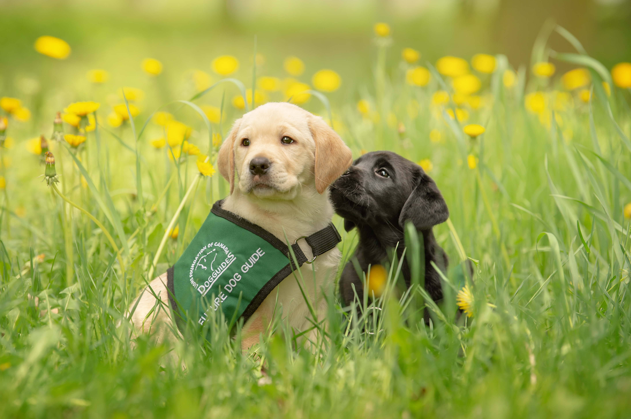
Barking: Tips
If your puppy barks at you for something (demand barking) totally ignore him until he stops (turn your back, fold your arms, step over a gate, look up at the ceiling)
  When he stops barking, give him your attention
Give your dog a stuffed kong so he can be profitably occupied instead of finding his own entertainment by barking
If your puppy barks to come out of his crate and you release him while he is barking, you have reinforced barking
  It will be much more difficult to keep him quiet in future
  Wait for quiet or use a treat to elicit quiet before opening the crate door

