Slide 1


Crating
Crating
Goals
How to start
What to look for
How to create good habits
Apartment tips

Slide 2
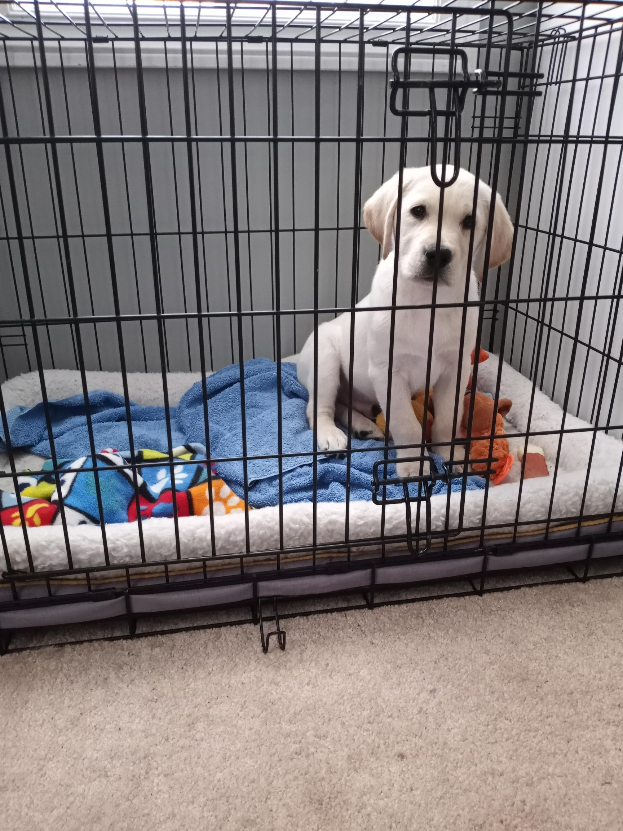
Goals
Puppy can settle in the crate both when alone and when people/distractions are present
The crate is essential for keeping puppy safe and helps with house training and prevention of bad habits in the home
Regular use of the crate helps to prevent separation anxiety; incorporate some time home alone into your weekly schedule
Being comfortable in their crate will also help puppy with the transition to the kennel environment when they are recalled for formal training

Slide 3
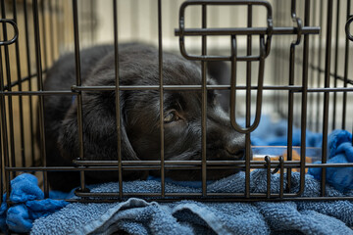
How to start
Start making the crate a fun place to be as soon as puppy arrives home
Every time the puppy goes in the crate, reward them with praise and/or a treat
You may feed puppy in the crate
Puppies may have a bed or blanket in the crate AS LONG AS THEY DON’T CHEW IT
Do not allow anyone to tease or bother puppy while they are in the crate
Keep a radio on near the crate for background noise
Cover the crate with a blanket to make it secure

Slide 4
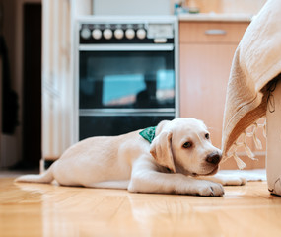
What to look for
If puppy is getting overtired or overstimulated, they need some time to unwind in the crate
Overtired or overstimulated puppies may:
Have the zoomies
Mouth relentlessly
Hump blankets, pillows or toys
Act restless
Puppy should be in the crate overnight, any time they are left home alone, and any time that you cannot be closely supervising them

Slide 5
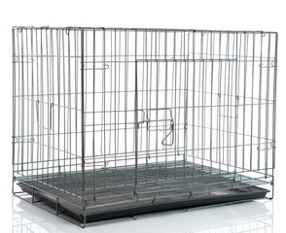
How to create good habits
Introduce the cue “kennel” to tell puppy to enter their crate; start by tossing treats in
Teach puppy to wait in their crate until released with “OK” when you open the crate door
Continue to use the crate regularly, both when you leave puppy alone and at times when you are home with puppy
Crate time is a wonderful opportunity to give puppy a special treat like a stuffed Kong

Slide 6
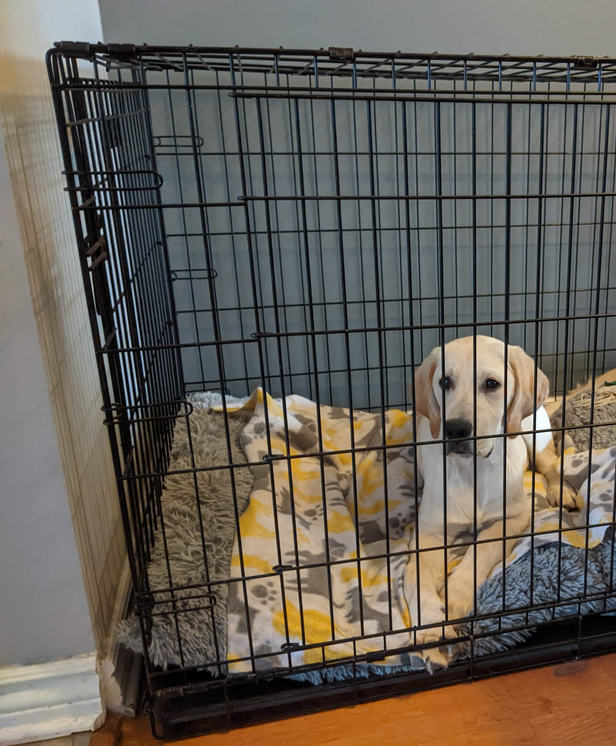
Apartment tips
If puppy is barking in the crate:
Without speaking to puppy, check on them and/or take them out to the bathroom to ensure they do not have to go out and are safe
If you have taken puppy out to the bathroom and checked on them, do not give puppy any attention or open the crate when they are barking or whining
Help puppy get more comfortable in the crate by having the crate in spot they can see you, and give them an appropriate chew or treat to occupy them in the crate

