Slide 1

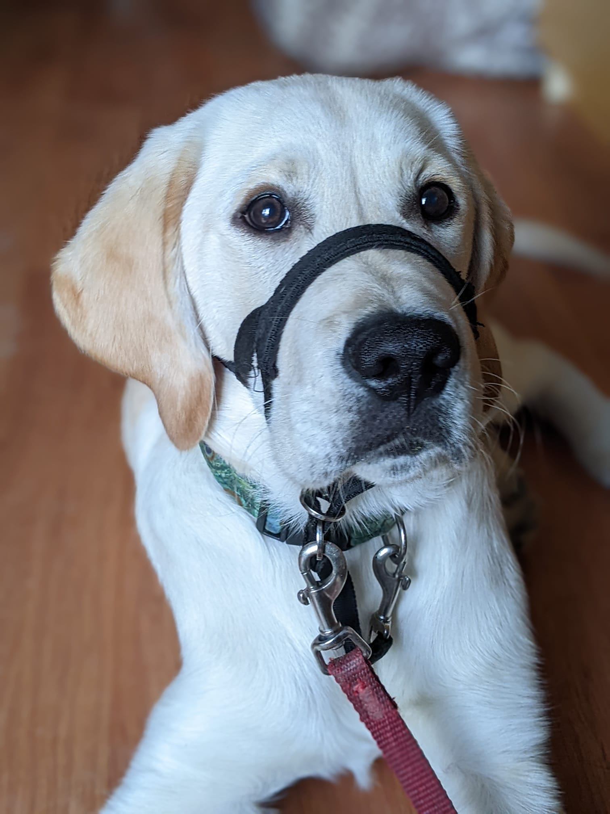
Equipment Use
Collar
Flat style only
Leash
Fabric or leather 4ft or 6ft
Jacket
Supplied by Dog Guides
Head halter
Supplied by Dog Guides
Crate
Supplied by Dog Guides

Slide 2
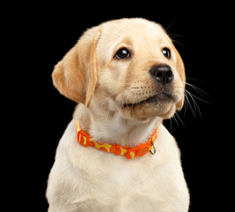
Collar
Puppy wears a collar in the kennel before going home, so they are used to the feel
A collar will be uncomfortable and/or ineffective if not fitted properly
With a flat collar, you should be able to slide two fingers flat against the neck under the collar with minor effort/resistance from the collar
Check the fit on a regular basis as puppy is growing, and as most adjustment fixtures can loosen over time
Do not take off collar by yanking it over puppy’s head
Remember to take puppy’s collar off while they are in the crate, as it can get caught and cause choking

Slide 3
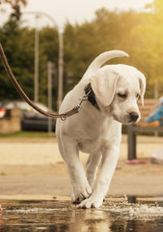
Leash
Puppy can get used to having a leash attached to their collar by clipping the leash to the collar and allowing puppy to walk while it drags behind them (while supervised)
The leash should be in a nice ‘J’ shape with no tension when walking with puppy
If puppy tends to carry part of the leash in their mouth on walks, try to treat puppy more frequently so they do not have time to carry it
Puppy may get excited when you bring the leash out, so have puppy in a sit to have their collar clipped to the leash
Leash corrections are not permitted

Slide 4
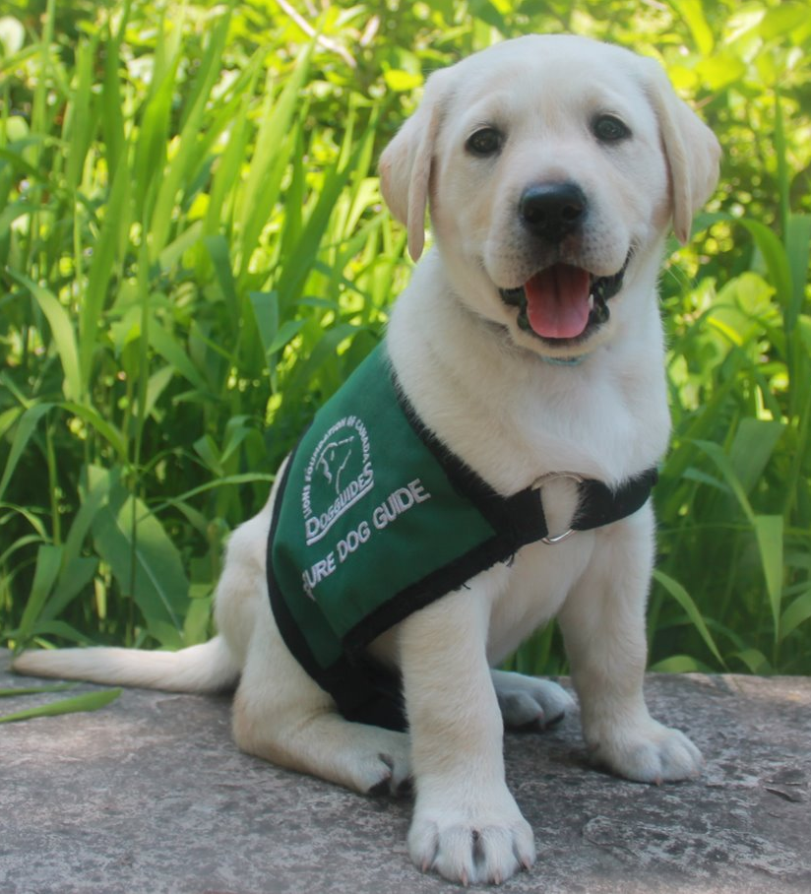
Jacket
Puppy jackets come in two styles, a buckle style and cape style with Velcro
Both styles come in a variety of sizes, however, the cape style does go to bigger sizes
Jackets should fit comfortably, not being too tight or too loose
Please do not amend the jacket yourself if there is an issue.
Introduce the coat in the home, putting it on at mealtimes to help develop a positive association, and removing the jacket when pup is finished their meal
For short in-home training sessions, put the jacket on, ask pup to do a few sits, give a few treats, encourage puppy to follow or come to you, give a few more treats and take the jacket off
People can pet puppy in jacket if puppy is sitting and calm
Ideally the jacket means work time
Always give puppy an opportunity to relieve themself before you put their jacket on

Slide 5
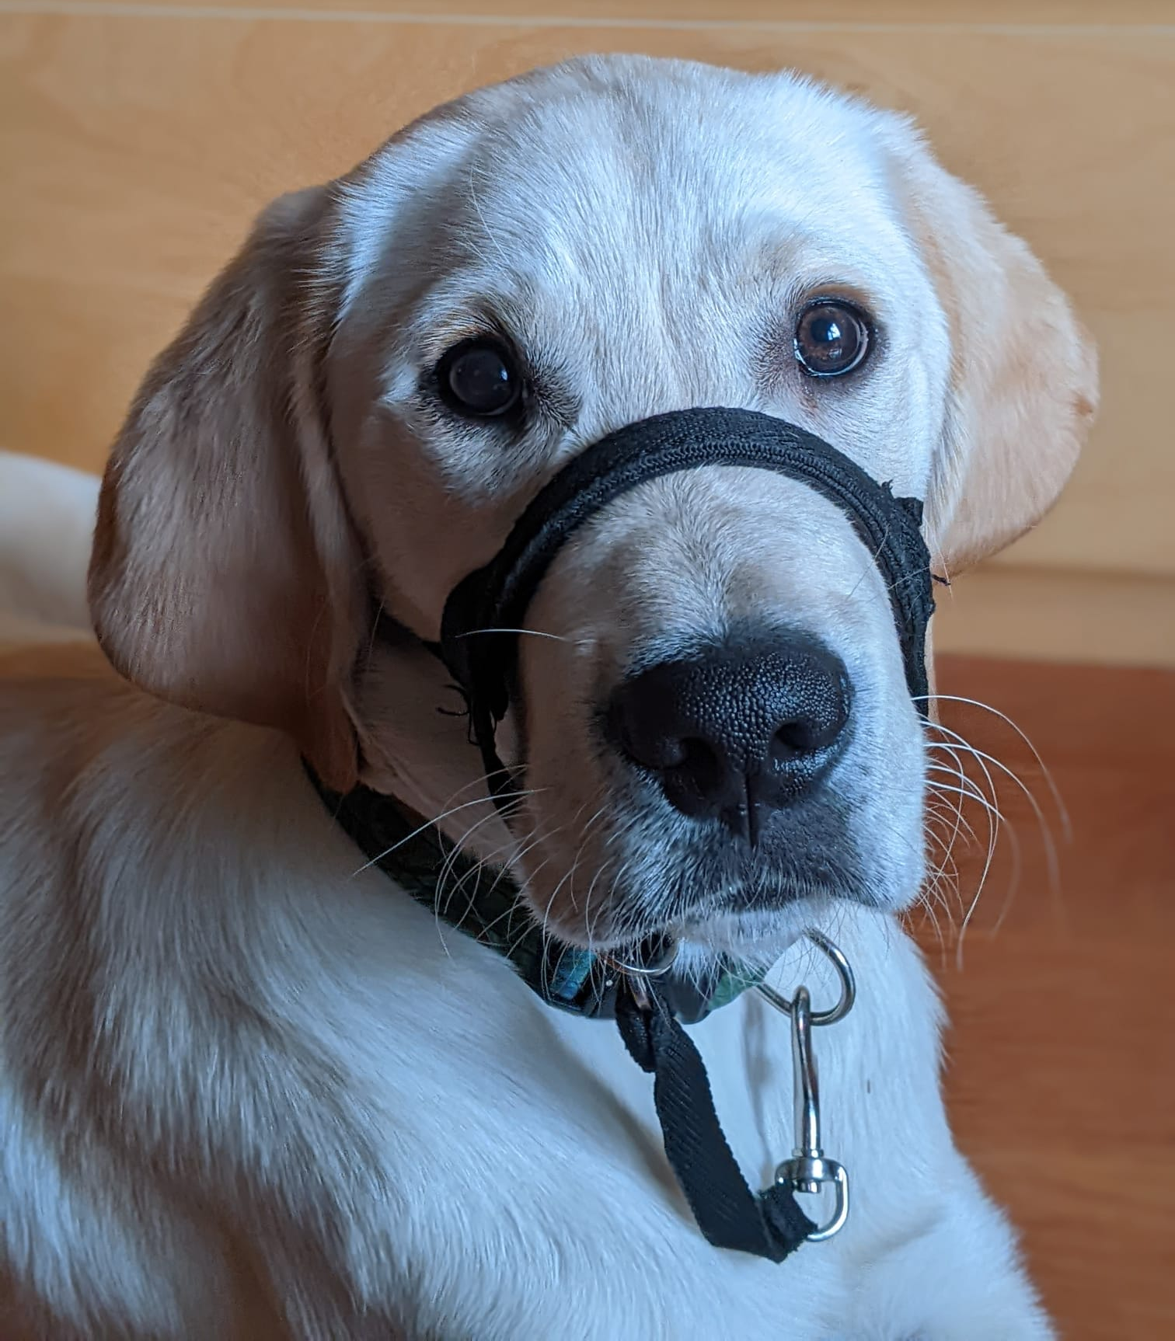
Head Halter
The head halter needs to be adjusted for comfort for effectiveness, as an ill fitted head halter can easily be removed, can impede them from opening their mouth fully, or can pull into the eyes
Head halters come in a variety of sizes, so ensure the head halter fits as puppy grows
Please do not amend the head halter yourself if there is an issue
Start by holding a treat through the opening that goes over the nose, when puppy puts their nose through the opening allow puppy to take the treat
Once puppy is comfortable putting their nose through, begin clipping the head halter on the back of puppy’s head
Have puppy wear the head halter for mealtimes, play session or short training sessions
The first time you do use the head halter with the leash, take pup for a short walk to get them used to walking with the head halter
Discourage any fussing, rubbing, or pulling with the head halter

Slide 6
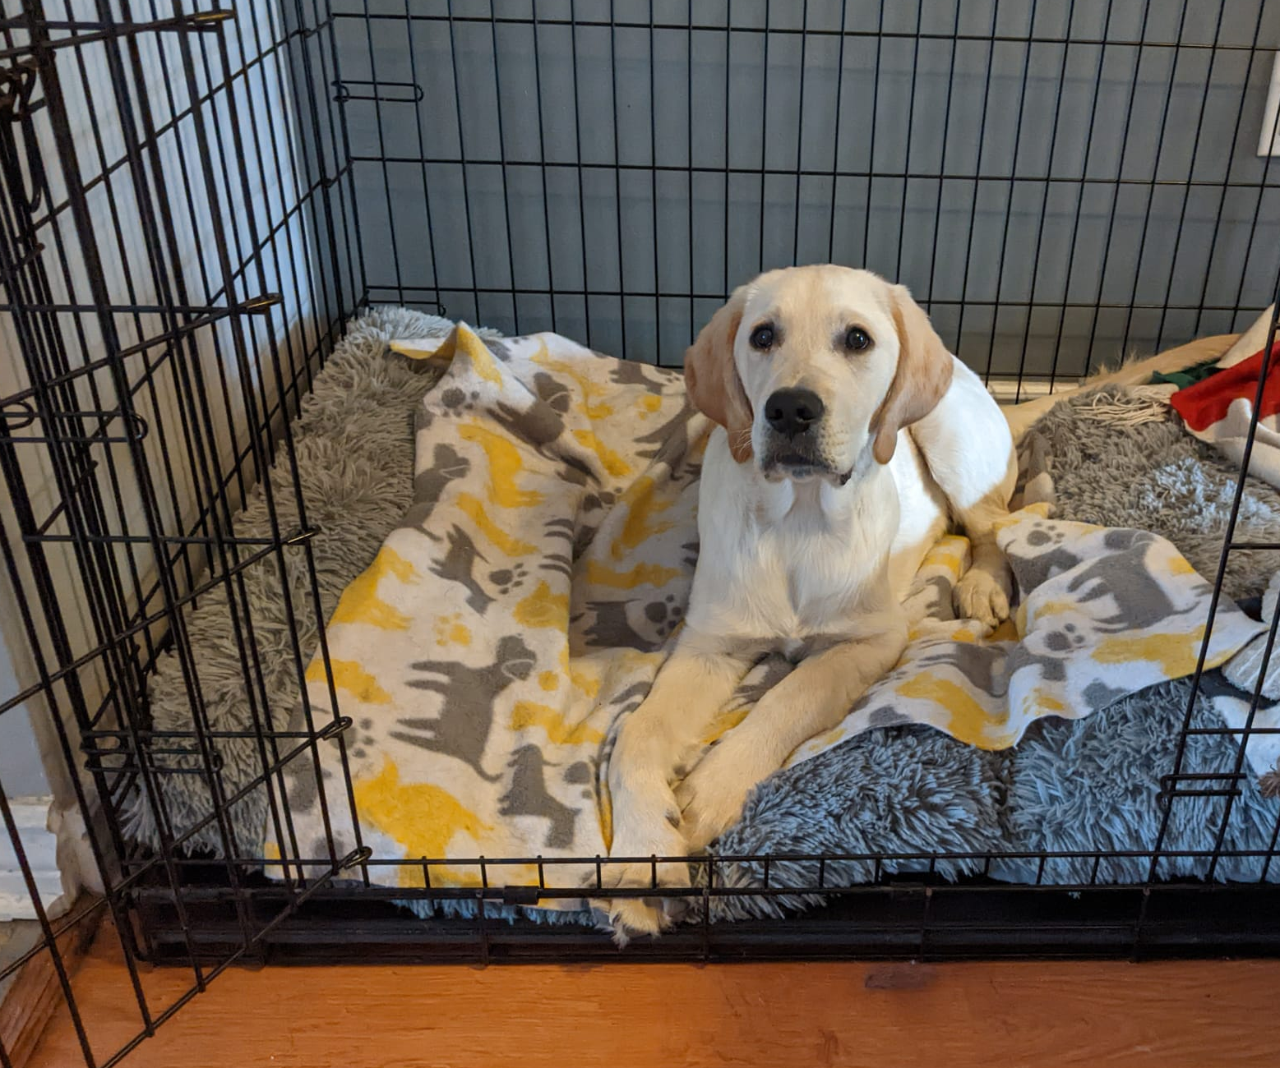
Crate
Introduce the cue “kennel” to tell puppy to enter their crate; start by tossing treats in
Teach puppy to wait in their crate until released with “OK” when you open the crate door
Continue to use the crate regularly, both when you leave puppy alone and at times when you are home with puppy
Crate time is a wonderful opportunity to give puppy a special treat like a stuffed Kong

