Slide 1

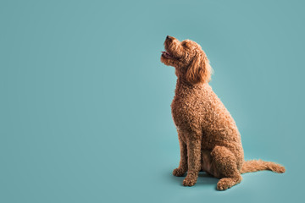
Handling Overview
Body handling
Grooming handling
Medical handling
Handling games

Slide 2
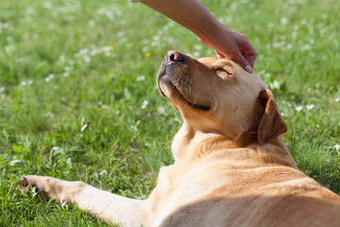
Body Handling
Practice at puppy’s comfort level touching them from head to toe
Treat puppy while touching them to building up the positive association
If puppy has any areas on their body that they are uncomfortable with you touching, take note and discuss with puppy staff what steps would be best to build puppy’s confidence with touch in the area
It is best to keep handling sessions short and positive

Slide 3
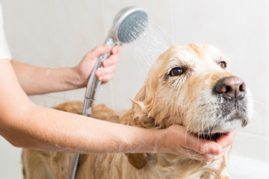
Grooming Handling
Baths:
Only use shampoo meant for dogs​
Dogs do not need to be bathed often, however; they should have a bath while they’re under 4 months of age for practice​​
You can smear some peanut butter on the tub wall to keep your puppy busy while you bathe them​​
Do not spray water into the dog's ears or face, use a cloth to clean their face​
Labs can be towel dried
Poodles need to be blow dried

Slide 4
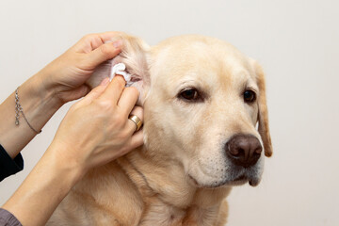
Grooming Handling
Ear Cleaning:
Only use ear cleaning solution meant for dogs​
Squeeze a small portion of ear cleaning solution into the ear​​
Using a cotton ball or a cotton pad wrapped around your index finger, gently wipe the visible part of your dog's ear canal and outer ear area​​
Reward your dog with treats and then repeat for the other ear

Slide 5
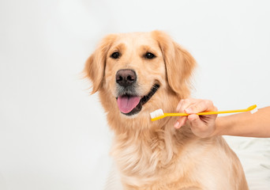
Grooming Handling
Teeth Cleaning:
You can start brushing your dog's teeth once they have their adult teeth​
Only use toothpaste meant for dogs​
You can use either a finger brush or a regular tooth brush​​
Be gentle and go in a circular motion with the brush​​
Brush your dog's teeth for about twenty seconds

Slide 6
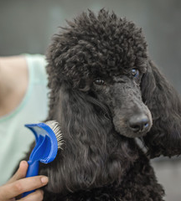
Grooming Handling
Brushing:
Labs can be brushed a few times a week​​
Poodles should be brushed daily
Matted fur tends to occur behind the ears, under the tail, around the groin and under the arms

Slide 7
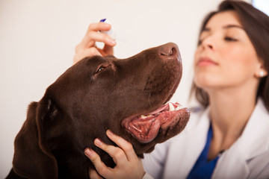
Medical Handling - Medication
It is good to get puppy comfortable with having medication administered
Examples to practice:
Use an eye drop bottle and pretend to put drops in their eyes
Use an ear drop bottle and pretend to put drops in their ears

Slide 8
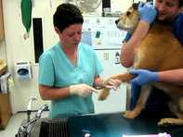
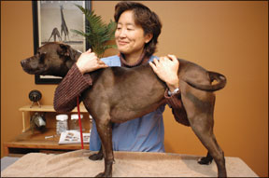
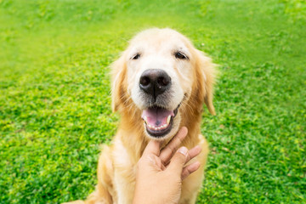
Medical Handling – Vet Holds
Blood Draw
Exam Hold
Chin Rest

Slide 9
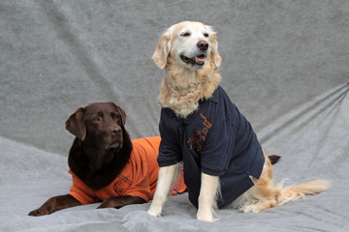
Handling Games
T-Shirt Game: put a loose fitting t-shirt on pup and then take off
Collar Grab: get a hand on puppy’s collar and treat puppy then release and repeat
Pressure Pets: apply different levels of pressure while petting puppy

