Slide 1

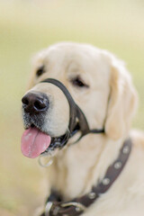
Head Halter Overview
Head Halter Diagram 1
Fit & Safety
Introduction Week 1
Introduction Week 2
Introduction Week 3
Introduction Week 4
Halti Vs. Gentle Leader

Slide 2
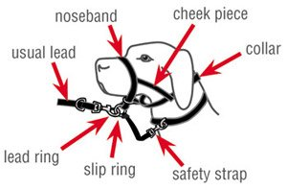

Slide 3
Fit & Safety
Strap at the back of the head should be snug (1 to 2 fingers underneath)​
The noseband should allow puppy to drink, eat, pant, etc.​
Never leave it on unsupervised (crate, car, under tables, etc.)​
  Do not allow puppy to chew it​
Once puppy learns to get it off, they will continue to get it off​
  Do not allow fussing (rub on legs or ground, paw at it)​
  Interrupt or redirect immediately
The safety strap should be clipped puppy’s regular collar

Slide 4
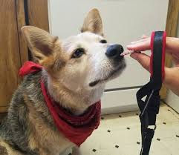
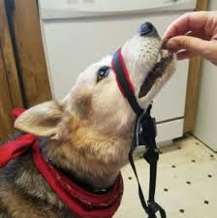
Introduction Week One
Step one: lure puppy’s nose through the head halter using a treat or kibble to entice puppy​
Step two: lure puppy’s nose using a treat or kibble through and rest the head halter on the bridge of puppy’s snout (start with a couple seconds and build up)
Step three: lure puppy’s nose using a treat or kibble through and put the head halter on for puppy to eat meals with it clipped loosely behind head, and take off when done eating
https://furfeatherworks.com/teaching-your-dog-to-wear-a-head-collar-gentle-leader-or-halti/

Slide 5
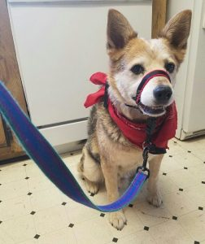
Introduction Week 2
Step four: once puppy is eating meals with the head halter on, you can then attach leash to slip ring, and let it hang while pup has a meal, and take off when done eating
Step five: put head halter on puppy, attach their leash to the slip ring and let it hang as puppy drags it around house under supervision for a few minutes
https://furfeatherworks.com/teaching-your-dog-to-wear-a-head-collar-gentle-leader-or-halti/

Slide 6
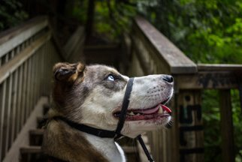
Introduction Week 3
Step six: put head halter on puppy and leash then go outside briefly for a short walk
  When starting out on walks with the head halter, clip the leash and the safety strap to the collar
  Once pup is more comfortable walking with the head halter on, move the leash clip to the slip ring under the chin and continue to use the safety strap to the collar

Slide 7
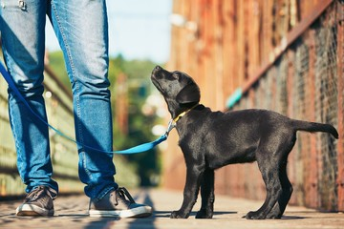
Introduction Week 4
Step seven: begin using the head halter in busier environments, this will help distract puppy
Remember:
  The head halter is to be used to aid with leash walking (not a band-aid)​
  Practice walking 50% of the time with the head halter and 50% with the collar

Slide 8
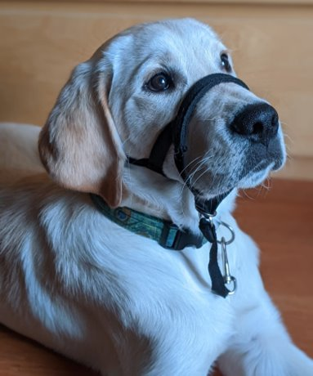
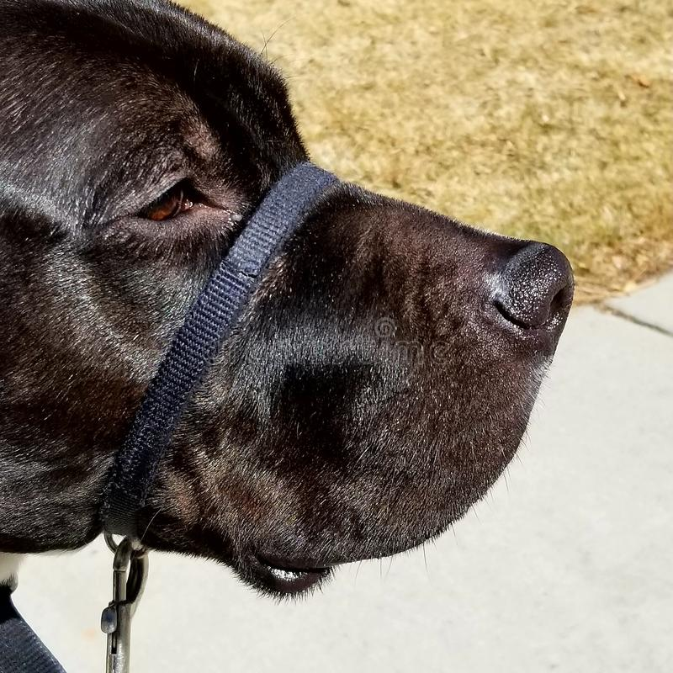
Halti Vs. Gentle Leader

Slide 9
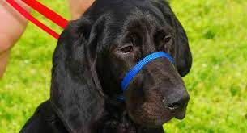
Halti Vs. Gentle Leader
Both provide additional help with walking pup
The Halti has the noseband and cheek piece whereas the Gentle Leader only has the noseband
The Gentle Leader care a good option for pups that are struggling to get used the Halti due to the simpler design of the Gentle Leader

