Slide 1

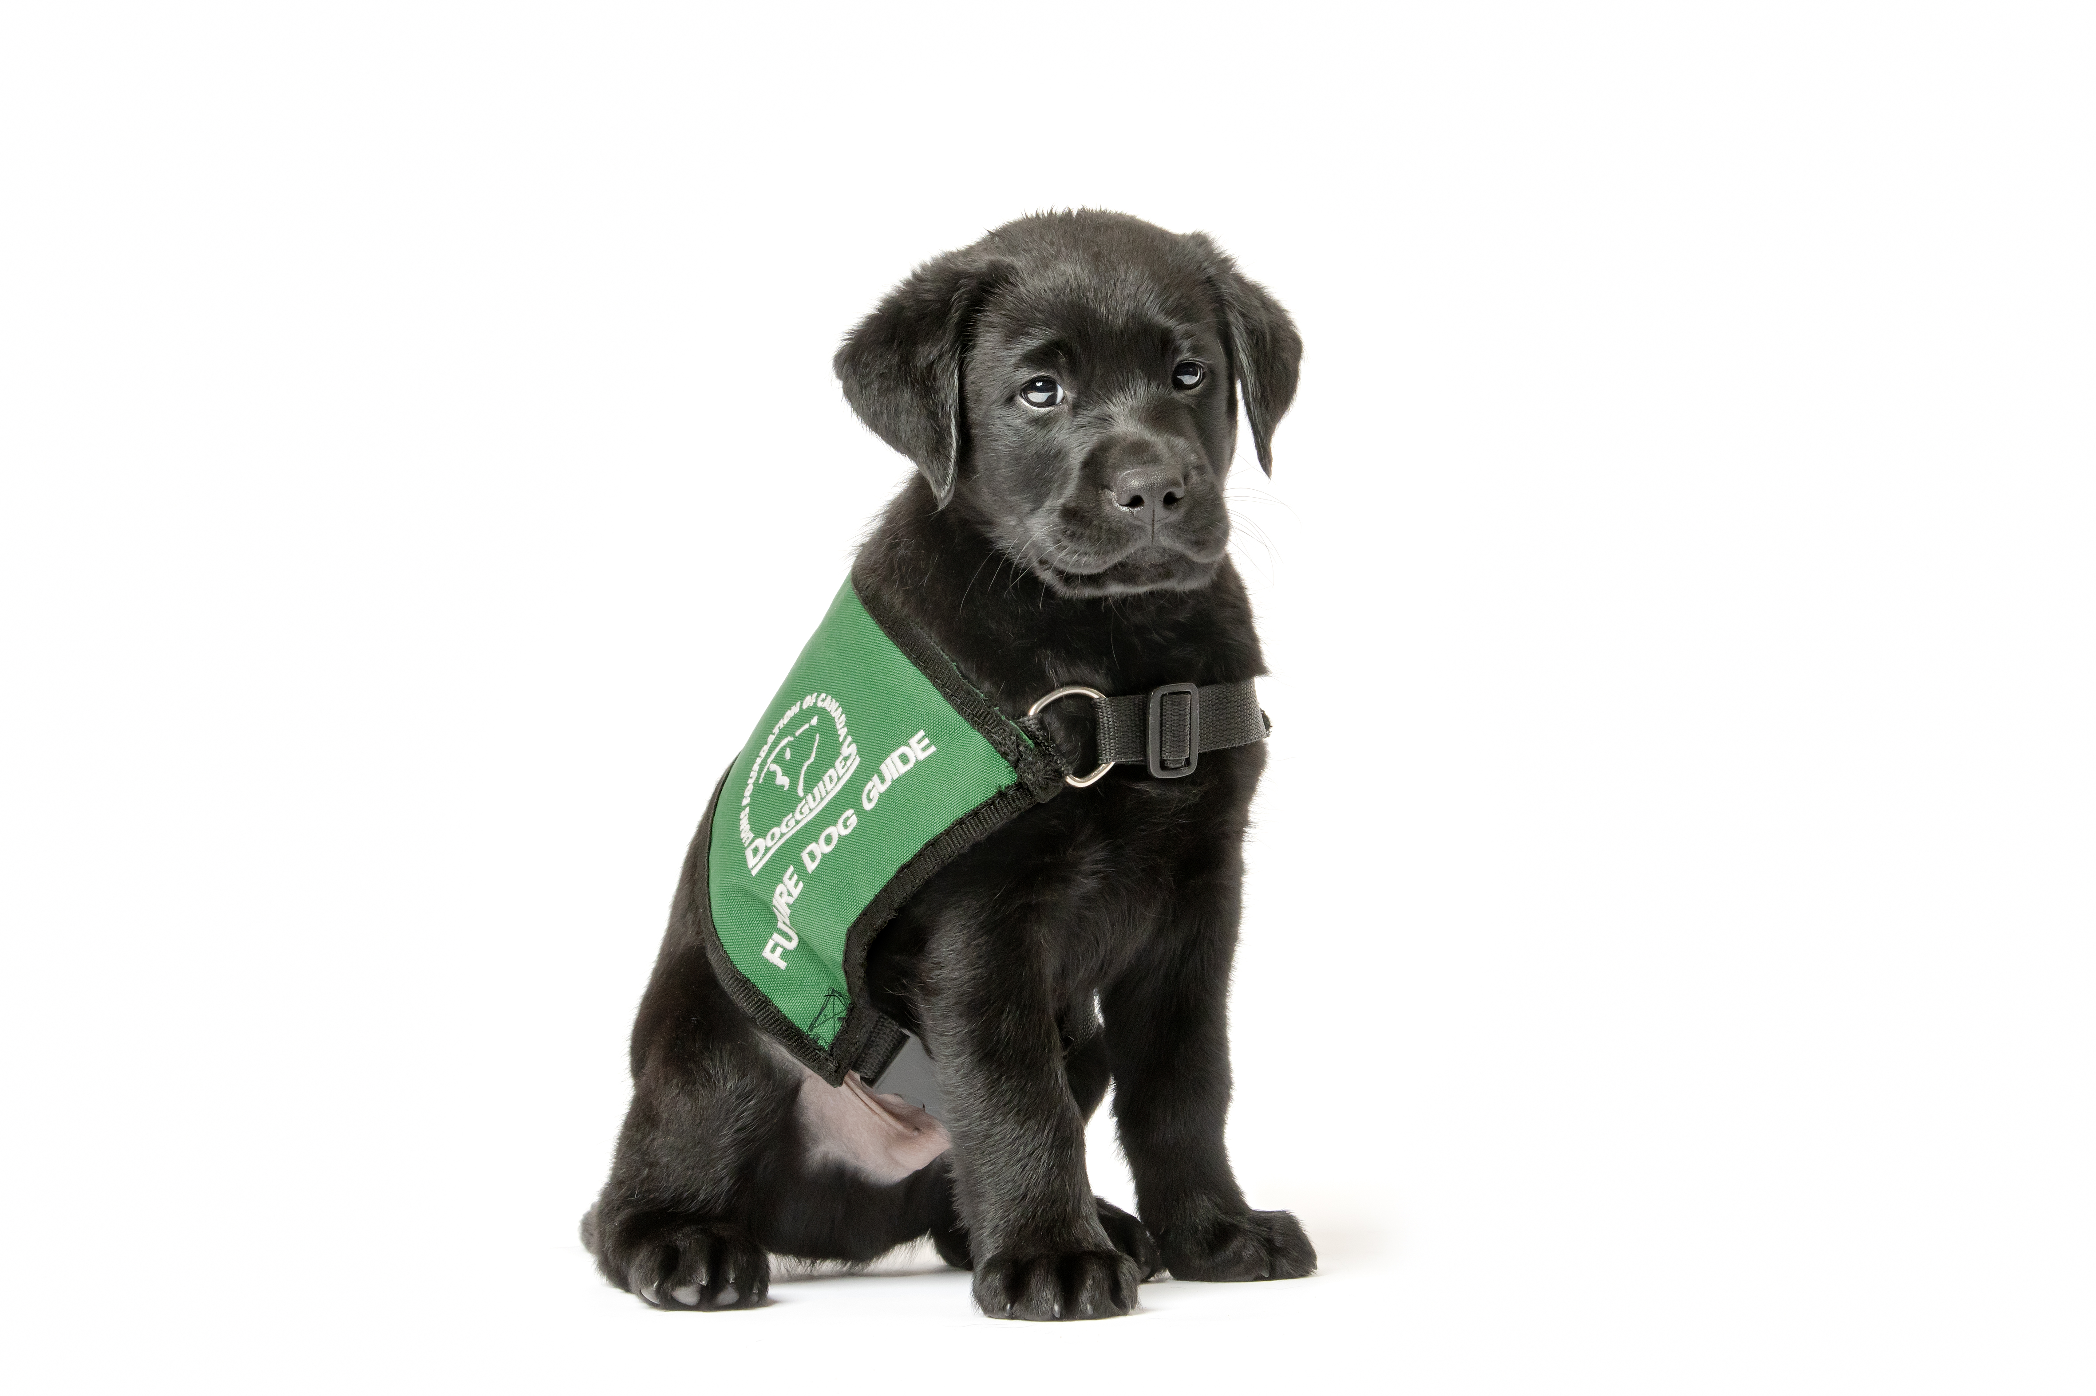
House Training
House Training
Goals
How to start
What to look for
How to create good habits
Accidents happen
Apartment tips

Slide 2
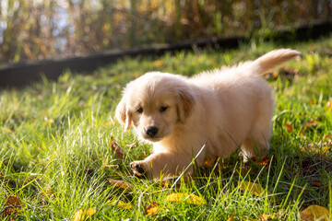
Goals
Puppy will relieve itself on cue (“Busy Busy”) in an appropriate place
After a period of pairing the cue “Busy Busy” with the action of eliminating, you will be able to begin to use “Busy Busy” as a cue to encourage puppy to relieve itself
Puppy should be comfortable relieving while on leash and on different surfaces

Slide 3
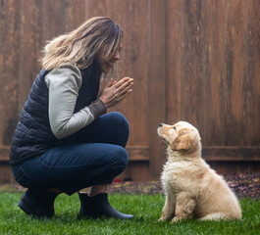
How to start
When puppy first arrives home, select a specific outdoor area for relief
Future Dog Guide puppies should NOT be trained with newspapers or an indoor potty
Each time puppy relieves itself, say the cue “Busy Busy,” and when they are finished reward them with praise and/or a treat
We do not want to train the puppy to “ask” to go out; instead, continue taking the puppy outside at regular intervals appropriate to their age

Slide 4
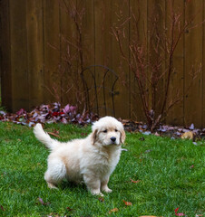
How to create good habits
Take them to the relief area:
First thing in the morning
After eating, drinking, napping, or play time
If they are sniffing or acting restless
At regular intervals throughout the day
Last thing before bed
Always remember to give puppy an opportunity to relieve itself before going out in public, and bring along a clean-up kit regardless of how old puppy is

Slide 5
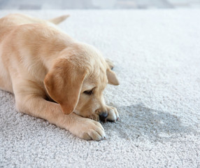
Accidents happen
If you catch puppy relieving inside, use your voice to interrupt them, and then immediately take them outside to the relief area to give them a chance to finish
You cannot correct a puppy for having an accident unless you catch them while they are eliminating; if you find a mess on the floor, simply clean it up and supervise the puppy more closely next time
Accidents can be cleaned up with a solution of vinegar and water or with cleaning products from the pet store

Slide 6
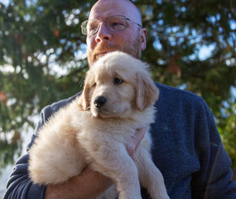
Apartment tips
Taking puppy out on a routine will help build the connection that puppy needs to do their bathrooms outside
Err on the side of taking puppy out more often than waiting until you think they have to go
Carry puppy outside during the first days home to help stop them from going to the bathroom while they walk outside
Go to the same spot every time you go outside the building and give puppy time to go to the bathroom before going back in

