Slide 1

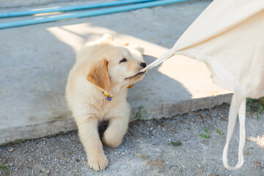
Teething
Teething
  Notes
  Steps to stop nipping
  Working on bite inhibition
  Tips

Slide 2
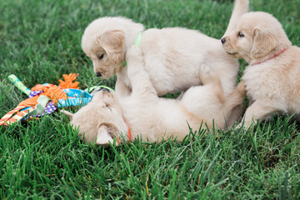
Teething: Notes
When pups play together and one gets too hard with their mouth, the offended pup will end the play
  The pup may yelp, bark, snap, walk away or any combination of these
  The puppy that was too rough has just learned to be gentler with their mouth, and usually will resume play after a few moments
Socialization is a key factor in puppy understanding bite inhibition
Puppyhood is the best time to establish these boundaries
As future service dogs, they are required to hold, carry, or tug on items and this needs to be done with a controlled mouth

Slide 3
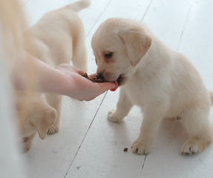
Teething: Steps to stop nipping
Step one: begin teaching your puppy to take treats gently
  Gentle command: no teeth to take treats
    Exercise: Hold treat in closed fist or under thumb with flat hand, pup needs to lick to get treat
    When licking you can add the gentle cue
    Can say OUCH/NO or yelp if puppy uses teeth
    Deliver treat right into pup’s mouth
This will take some time, so in the meantime steps 2 and 3 are extremely important

Slide 4
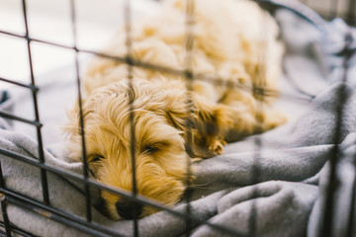
Teething: Steps to stop nipping
Step two: Puppies will try a variety of behaviours until they get the desired outcome (likely attention). If they begin to use their mouths hard when interacting with you, you can:
  Give them a toy to hold before they put mouth on you
  Walk away (if they are in a safe environment and cannot follow you)
  Stepping over a baby gate or having pup on leash and tethering (careful they don’t chew the leash)
  Quick time out (5-10 seconds) in their crate (lead them into the crate with leash or kibble)
  Generally, give pups 3 tries to come out and continue interacting, if they go right back to nipping, they can spend a longer amount of time in the crate (most likely they are over-tired)

Slide 5
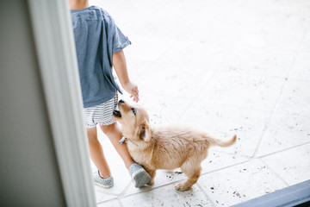
Teething: Steps to stop nipping
Step 3: Ensure no one is interacting/playing with puppies in a manner that is going to get them worked up/over-excited as this will lead to more mouthing
  For example, wrestling with puppy or playing tug of war are inappropriate games that encourage over excited play
  Moving your hands quickly around puppy’s face will make puppy want to nip at your hands
  Do not hold puppy’s mouth shut after they attempt to nip, as puppy will only think it is a game and not the negative reinforcement you were hoping for

Slide 6
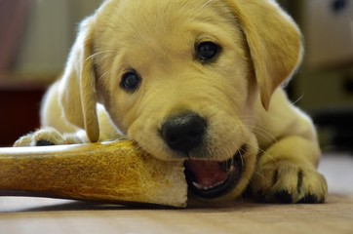
Teething: Working on bite inhibition
Bite inhibition helps to teach the dog acceptable levels of pressure to use with other dogs, people, and items. Bite inhibition means training for a soft mouth. Exercises to try:
  Hand feed puppy: try to feed puppy by hand once a week
  Practice ‘gentle’ command: hold the kibble between your thumb and index finger and tell pup to be ‘gentle’. If pup applies too much pressure you need to yelp or say “OW” to make puppy think you are in significant pain. The only way you are going to release that kibble is when puppy is being polite with their mouth.
  Give more: try adding more kibble into puppy’s food bowl, so hands near food becomes a positive association
  Trade: if puppy has a toy, try to trade with puppy the toy for a high value treat

Slide 7
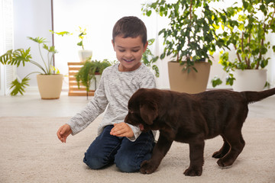
Teething: Tips
When dealing with mouthy pups do not perform any quick motions as pup will likely follow and make contact with their mouth first
For children, teach them to “be a tree”: plant their roots (keep their feet still to stop movement), fold in their branches (cross their arms on their chest), and call an adult for help
Nipping can go through phases as pups lose more teeth & their gums become more irritated

Slide 8
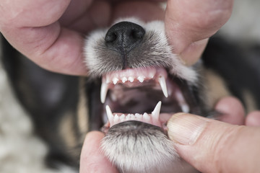
Teething: Tips
If you’re not seeing an improvement with nipping the behaviour is somehow being rewarded.
  Either puppy still sees it as a game, the consequence isn’t consistent (eg: sometimes they go into the crate and sometimes play continues), or something else is going on
  Please speak to puppy staff so they can give you some insight
As pup gets older and have learnt some bite inhibition, we can work on an excite and settle exercise
  Looking for the ability of our pups to get worked up and then when we stop interacting, they settle themselves instead of continuing to interact

