Slide 1

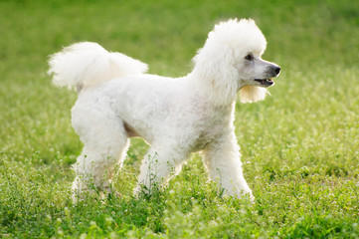
Poodle Grooming Overview
Brushing
Types of Brushes
Nails
Bathing
Ear Cleaning
Teeth Brushing
Clipping a Poodle
Plucking Poodle Ears
Poodle Grooming Tips

Slide 2
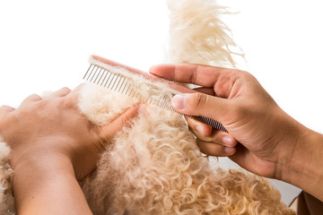
Brushing/Combing
Poodles should be brushed/combed daily​
Matted fur tends to occur behind the ears, under the tail, around the groin and under the arms

Slide 3
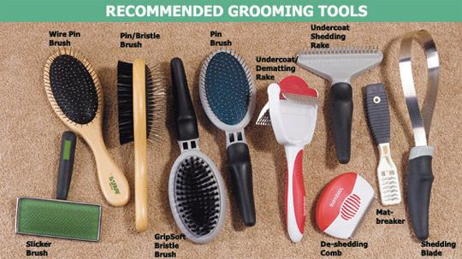
Types of Brushes
http://veterinary-tips.ucoz.com/blog/using_the_right_tool_for_your_pet_s_hair/2014-10-01-382

Slide 4
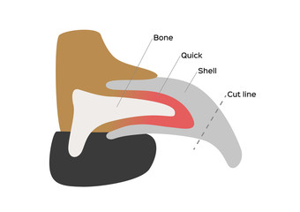
Nails
Nail trims are one of the most frequent procedures that dogs experience​
If you’re uncomfortable clipping nails yourself, you can take your dog to a vet clinic or groomer to have their nails cut, but you can still practice the process at home without actually cutting nails​
Make sure their nails are cut at least once a month

Slide 5
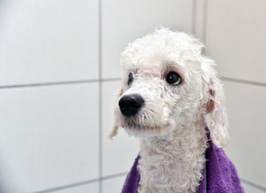
Bathing
Only use shampoo meant for dogs
Dogs do not need to be bathed often, however; they should have a bath while they’re under 4 months of age for practice​
You can smear some peanut butter on the tub wall to keep your puppy busy while you bathe them​
Do not spray water into the dog's ears or face, use a cloth to clean their face
Poodles need to be blown dry, while labs can be towel dried

Slide 6
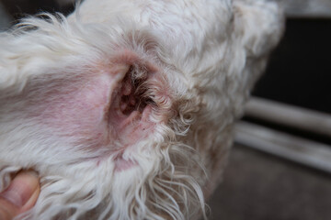
Ear Cleaning
Only use ear cleaning solution meant for dogs
Squeeze a small portion of ear cleaning solution into the ear​
Using a cotton ball or a cotton pad wrapped around your index finger, gently wipe the visible part of your dog's ear canal and outer ear area​
Reward your dog with treats and then repeat for the other ear

Slide 7
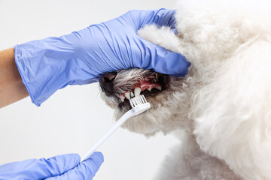
Teeth Brushing
You can start brushing your dog's teeth once they have their adult teeth
Only use toothpaste meant for dogs
You can use either a finger brush or a regular tooth brush​
Be gentle and go in a circular motion with the brush​
Brush your dog's teeth for about twenty seconds

Slide 8
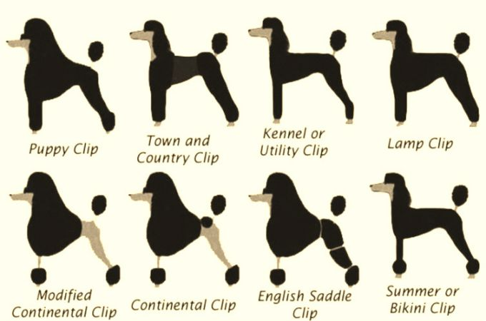
Clipping a Poodle: Different Clips
https://teacupdogdaily.com/poodle-haircuts-clips-list/

Slide 9
Clipping a Poodle: Preparation
Your dog should be bathed, blow-dried (if possible) and thoroughly combed out.
Please use a comb and not a slicker brush for this.
A comb is the only tool that will get right down to the skin and comb out any mats.
A slicker brush is appropriate only for finishing the coat by fluffing out the hairs.
This is because slicker brushes glide over the surface of the hair and do not get down to the skin, leaving a dense layer of compacted hair right along the surface of the skin.

Slide 10
Clipping a Poodle: The Kennel Clip
The kennel clip is the easiest clip to perform and is also the most efficient for keeping your dog comfortable and mat free.
It is important to remember that your foster puppy is a working dog, and not a pet or show dog – therefore the kennel clip is the most appropriate clip.
The head and tail are usually clipped with a #4 blade, leaving them slightly longer than the body.
The ears are clipped with the same length of blade as the body (#4 or #7).
If you are willing to take on the required extra maintenance, it is an option to leave a topknot and longer tail and ears, but the hair must be scissored to the desired length.
The feet, face and bum and base of tail are shaved clean with a #10 or #15 blade.

Slide 11
Clipping a Poodle: Maintenance
Poodles should be fully clipped every 4-8 weeks depending on your preferences and how fast your dog’s hair grows.
In the summer it is beneficial to clip more often so as to keep the hair shorter during the months of high temperatures – whereas in the winter it is okay to let the hair grow out a little longer between clips for warmth.
The face and bum should be shaved at least once between full clips to help keep these areas clean and infection free.
Feet can also be shaved between clips; however, this is up to personal preference.
Pay close attention to areas that tend to mat: elbows, armpits, seat bones, underneath ears, topknot, and wherever halti and collar sits. Mats are not something that happen in a well-maintained poodle and are unacceptable. Mats are also painful for your dog, as the matted hair pulls constantly on the skin underneath.

Slide 12
Plucking Poodle Ears
Thinning out the hair inside the ears can help to keep the ear dry and prevent ear infections.
If you keep on top of plucking the hair, even just doing a little bit every other day while you watch TV, then you will find that it does not have to be a “big deal” for puppy.
You can buy ear powder for dogs which will give you better grip on the hairs.
Use your thumb and forefinger to grab a small piece of hair and pull quickly.
Try not to grab too much hair at once as this can be surprising and painful for your dog.

Slide 13
Poodle Grooming Tips
Puppies have their face and bums first shaved at 6 weeks before you bring them home. If you start early and continue desensitizing with the clippers from day one at home, you will encounter less problems in the future.
Be positive! If your puppy is fussing about being clipped, make sure you keep sessions short and positive. Do not allow your puppy to get away with pulling legs, feet, face out of your grip. Hold on firmly and let go once your puppy has relaxed. Reward with verbal praise and a treat. If you have to groom over the course of a few days, that is okay. Try to remember to stop and reward when your puppy is being good, not just waiting for your puppy to fuss.
Check frequently that the blade does not get hot. Test the blades temperature by carefully laying the blade on your cheek – if it is uncomfortable for you, than it too hot. Spray blade with coolant or remove blade from clippers and give it time to cool down. Placing the blade on a cold, wet face cloth over an ice pack is another option for cooling the blade down quickly.

Slide 14
Poodle Grooming Tips
Stretch out the skin as you clip. By stretching the skin out, you create a flatter surface which you are less likely to cut and produces a smoother clip.
When shaving the face, having a good grip on the dog's muzzle will help keep the dog’s face steady for clipping, and also prevent the dog from flinching away from you. Place your hand around the muzzle so that your fingers lay on top of the bridge of the nose, and your thumb rests in the gullet under the chin. Maintain gentle pressure, increasing the pressure if your dog squirms. This way of holding the muzzle prevents the dog from opening its mouth. Ensure that once your dog relaxes, you release the pressure and reward.

