Slide 1


Preparing for Recall
What to expect at drop off
Overview
Reminders
When do you see puppy again
Life in the kennel
Basics
Playtime
Skills
Outings
Future outcomes
Career change
Graduation

Slide 2
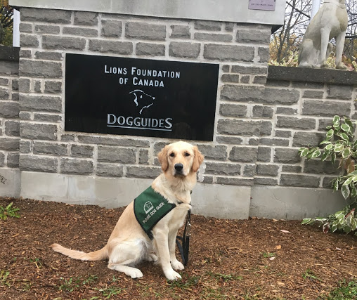
What to expect at drop off: Overview
Puppy staff will get in touch with you to arrange recall drop off details (i.e. location, timing, equipment to return etc.)
At drop off:
Some fosters like to take a picture of puppy in front of the building
Puppy or kennel staff will go over the recall form
Puppy or kennel staff will ask if you would like your equipment deposit returned, kept on file or donated
If puppy has not been spayed or neutered yet, staff will ask if you are able to take puppy back for their future recovery

Slide 3

What to expect at drop off: Reminders
Puppy does not need their favourite toys, dog beds or blankets to go with them unless you are comfortable with the items being donated to be used by any kennel dogs
Puppy is usually excited to be at the facility, so it is good to say good bye for now before getting to the facility
Left over food can be returned to kennel or given to another foster
Updates on puppy are available quarterly from puppy’s trainer or by request from puppy staff

Slide 4

When do you see puppy again
When puppy is in training, it is up to the trainer to decide when they will send puppy home for a break
Breaks from training include holidays like Christmas break and long weekends
Trainers decide whether it is appropriate for puppy to return home, go to another trainer’s home or go to a sitter if puppy needs to continue to work on certain behaviours

Slide 5
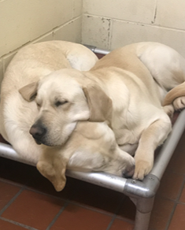
Life in the kennel: Basics
Puppy meets their new kennel mate in the courtyard for a play session before going into their kennel
Trainers get to know their new recall pups by playing with them and walking them
Trainers notice pups’ strengths/weaknesses as well as their personalities
Most pups get settled into the kennel quickly; however the few pups that struggle with kennel life are optioned for a day school structure

Slide 6
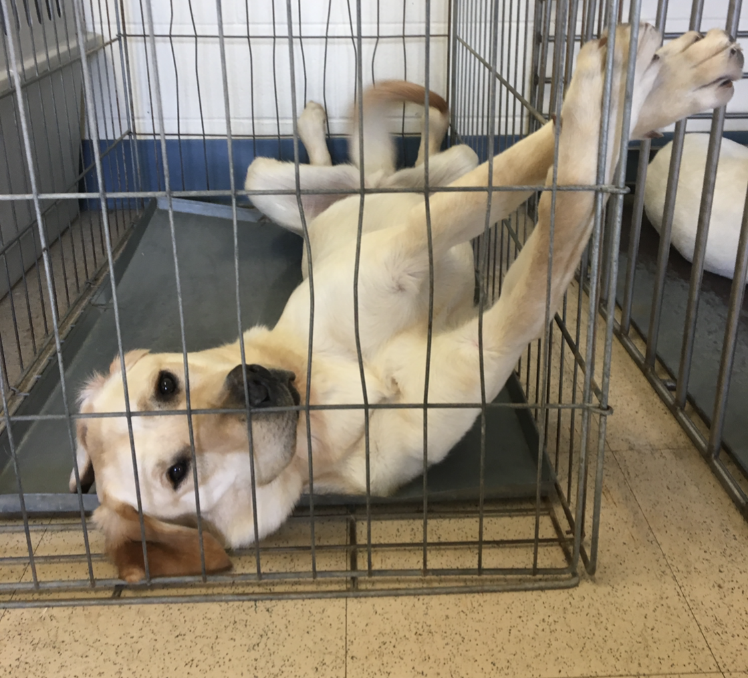
Life in the kennel: Skills
Trainers start with basic kennel manners:
Settling in their crate
Not eating items off the ground
Sitting nicely before coming out of the kennel
Walking into their collar and equipment
Doing well with distractions
The skills all trainers work on include:
Impulse control
Recall (come command)
Eye contact
Checking in

Slide 7
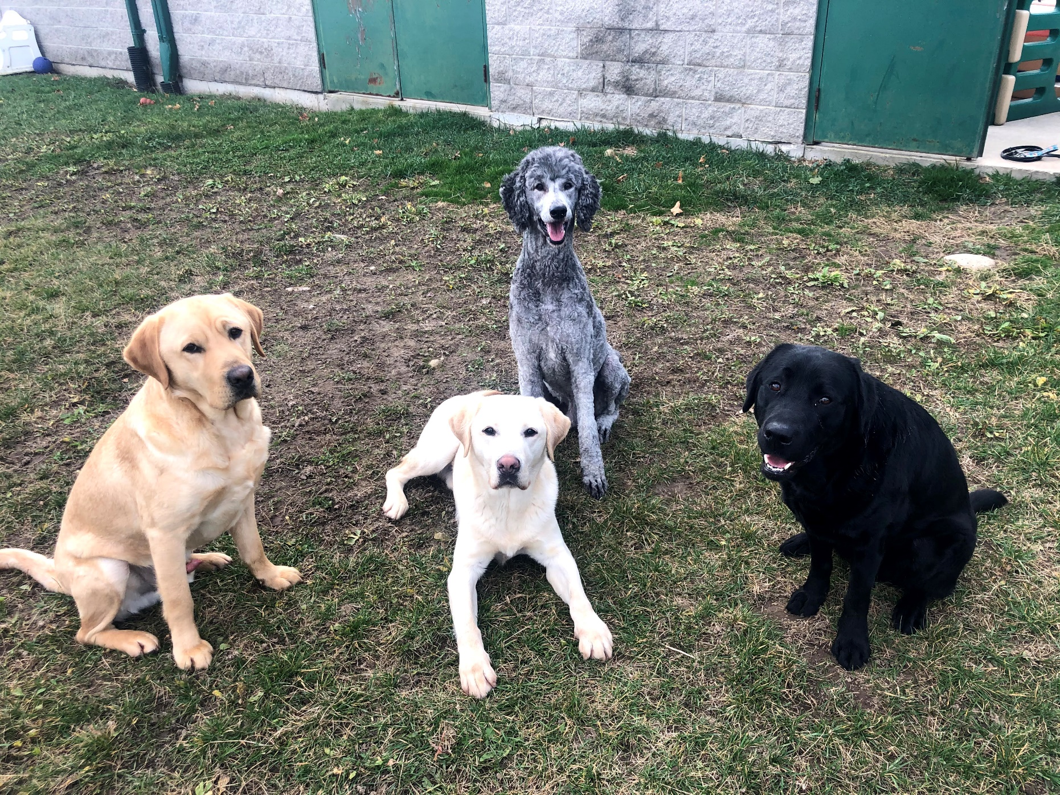
Life in the kennel: Play time
Play time is part of each day, in the courtyards and fenced off leash areas
Play time allows the pups to socialize, exercise and enjoy themselves
Pups also learn how to play appropriately

Slide 8
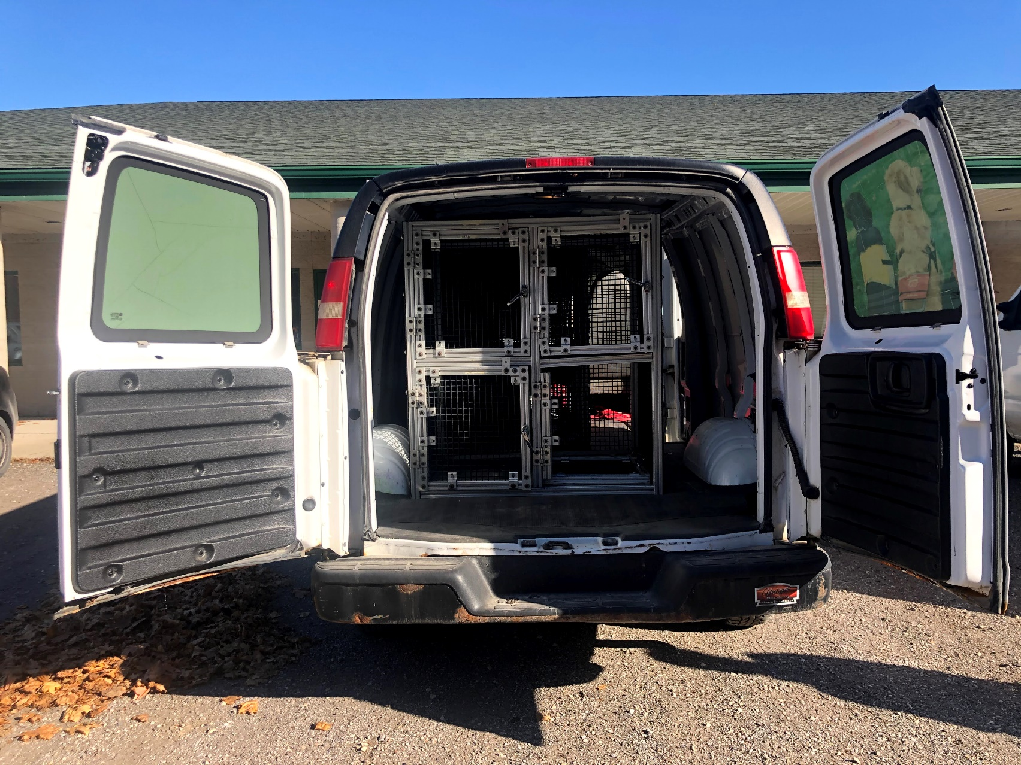
Life in the kennel: Outings
Outings are built into the training routine
Trainers take the pups to local malls, grocery stores, coffee shops, parks schools and airports
Outings allow puppy to work on program skills, build confidence and settle around distractions
Puppy goes on outings in one of our vans

Slide 9

Future Outcomes: Career change
It takes time for puppy to settle into the kennel, learn new skills, and be assessed for their recall program
Puppy may be transferred to another program if they are not successful in the program they were recalled for
Puppy may also be assessed by border services to see if a career with them is viable
If puppy is not suitable for a working career, you will be notified

Slide 10

Future Outcomes: Graduation
When puppy is successful in their program, they are then matched with a client
Depending on the client’s capabilities, puppy’s skills are tailored to meet the clients needs
The client then meets and trains with puppy
Graduation occurs to celebrate the completion of training for puppy and client, which you will be invited to

