Slide 1

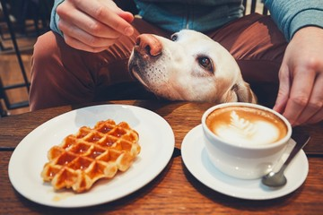
Prepping for Outings Overview(*with the exception of office/work situations)
What to take
Where to go
When is puppy ready
How long to go
Who can pet puppy
Signs puppy is overwhelmed
Best way to end the outing
Reminders

Slide 2
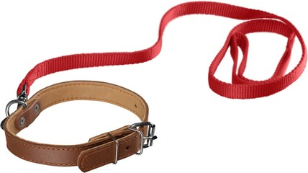
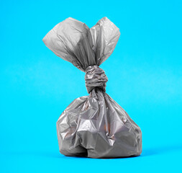
What to Take
What to take on your outing with puppy:
Treat pouch with treats
Puppy ID card
Puppy jacket
Puppy head halter (optional)
Puppy leash & collar
Clean up kit
Poop bags
Paper towel
Hand sanitizer
Wet wipes

Slide 3
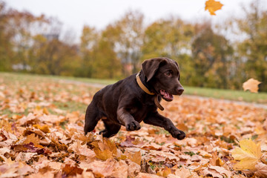

Where to go
Outing Ideas – Unvaccinated Pup (Under 16 weeks old)
Watch traffic
Drive through a drive-thru
Car ride around the block
Play different noises at home
Use seasonal weather as distractions i.e. fall leaves, winter snow, spring thaw/melt, and summer garden etc.
Outing Ideas – Vaccinated Pup (Over 16 weeks old)
Coffee shop
Grocery store
Restaurant patio
Library
Outdoor event i.e. Farmer’s market, Holiday parade, family BBQ etc.

Slide 4
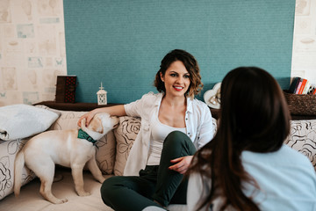
When is Puppy Ready
When is puppy ready for an outing:
Puppy is reliably house trained
Puppy walks calmly on leash
Puppy is fully vaccinated
For outings in high traffic areas
Puppy is comfortable in jacket

Slide 5
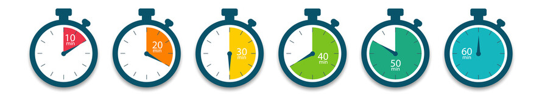
Prepping for Outings: How long to go
How long to be out with puppy depends on their age
Under 3 months old – 5 to 10 minutes
3 months old to 5 months old – 10 to 20 minutes
5 months old to 7 months old – 20 to 30 minutes
7 months old to 9 months old – 30 to 45 minutes
9 months old to 11 months old – 45 to 60 minutes
11 months old to 12 months old and older – 60 minutes plus

Slide 6

Who Can Pet Puppy
Who can pet puppy during an outing
It is up to you as to how many people pet or interact with puppy
You can always say no to people who approach puppy
There will be some people who pet puppy without permission
Try to be as polite as possible when interacting with the public

Slide 7
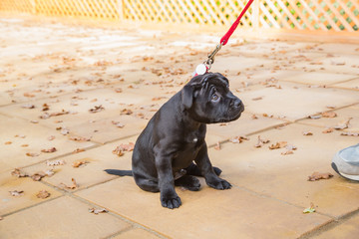
Signs Puppy is Overwhelmed
Signs puppy is overwhelmed:
Puppy refuses to continue walking
Puppy yawns excessively
Puppy licks lips excessively
Puppy’s ears are back
Puppy’s hackles are up
Puppy has a tantrum
Puppy mouthing you
Puppy barking inappropriately
Puppy alligator rolling on the floor
Puppy playing tug with leash

Slide 8
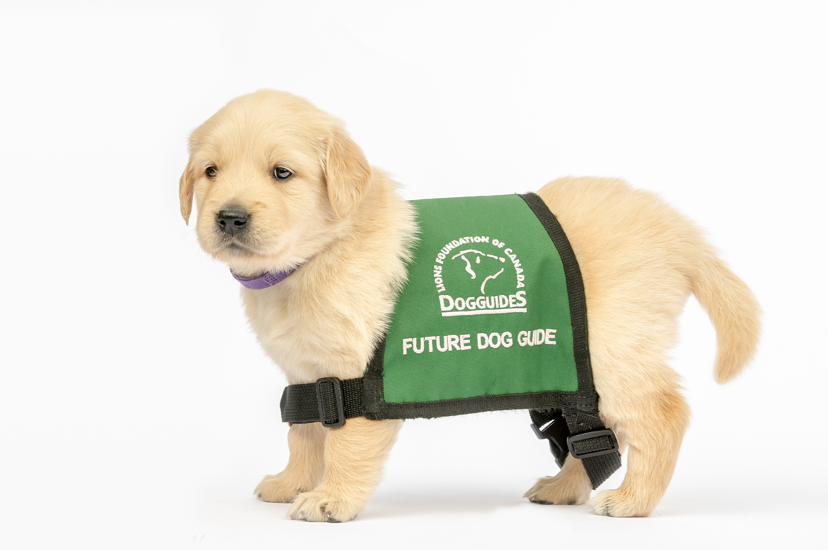
Signs Puppy is Overwhelmed
When you have realized puppy is overwhelmed, the best way to end the outing is:
Go to a quiet area
Ask puppy for a sit or a down
Reward and praise puppy
Head home

Slide 9

Reminders
Have puppy go to the bathroom outside in an appropriate area before going into the establishment
Remember to remove puppy’s jacket for them to go to the bathroom
Start with low distraction areas or quiet times
Build up puppy’s confidence by trying different locations to explore new environments

