Slide 1

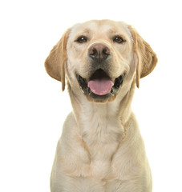
Resource Guarding Overview
What is resource guarding
Body language to watch for
Signs to watch for
Ways to encourage positive associations

Slide 2
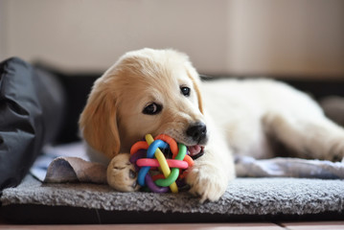
What is Resource Guarding
The dog might growl, stiffen, lunge or bite when you go near or try to retrieve something they deem valuable
Typically, dogs will resource guard toys, food, or bedding
Sometime stolen or found items are guarded like a dropped tissue, a granola bar wrapper, or sock
It is a common dog behaviour, but can also escalate over time
Never push a resource guarding dog past his threshold
Use good management techniques and classical conditioning to diffuse guarding behaviour

Slide 3
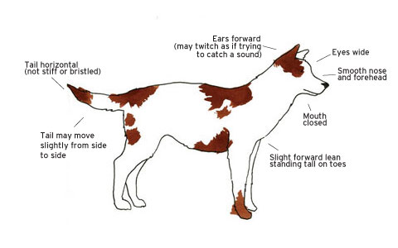
Body Language to Watch For

Slide 4
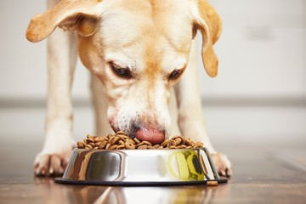
Signs to Watch For
Eating even faster when people approach
Hunching over food bowl
Stiffening when people approach food bowl
Looking up with a hard stare
Hunching over item and growling

Slide 5
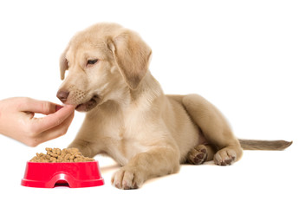
Ways to Encourage Positive Associations
Hand feed puppy a few meals each week
Sit on the floor with puppy and feed him kibble from his bowl
If puppy begins to resource guard the bowl, pick up the bowl, put it on the counter and try again in ten minutes to hand feed puppy

Slide 6
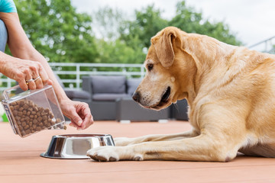
Ways to Encourage Positive Associations
Add to puppy’s bowl
Add more kibble to puppy’s bowl while it is on the floor
Touch puppy then add a high value treat to puppy’s bowl while it is on the floor
Pick up puppy’s bowl and put a high value treat in the bowl then put it down on the floor for puppy
Have puppy eat in a main area with the members of the household around
This will help puppy understand when people are around food gets better

Slide 7
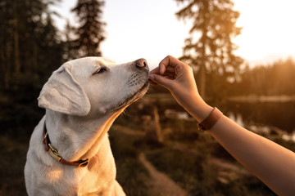
Ways to Encourage Positive Associations
Practice the gentle command
Hold the kibble between your thumb and index finger and tell pup to be ‘gentle’
If pup applies too much pressure you need to yelp or say “OW” to make puppy think you are in significant pain
The only way you are going to release that kibble is when puppy is being polite with their mouth

Slide 8
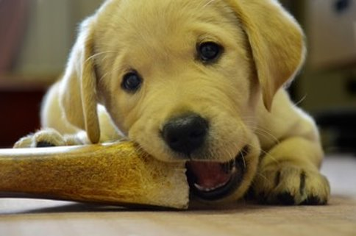
Ways to Encourage Positive Associations
Trade
It is important that when something is taken from puppy, that an item of equal or high value replaces it
Practice trading items with puppy i.e. a toy for a toy, a toy for a treat, a treat for a toy etc.
Give puppy the item, let puppy play with it, then offer puppy a different item to take the original item from puppy
Example: Give puppy a nylabone, let puppy play with the nylabone, then offer puppy a milkbone cookie to take the nylabone from puppy

