Slide 1

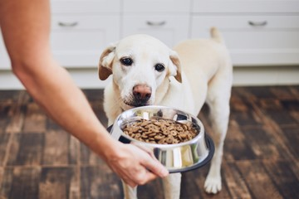
Resource Guarding Review
Resource guarding defined
Body language to watch for
Signs to watch for
Your choice affects puppy’s choice
What to do
What not to do

Slide 2
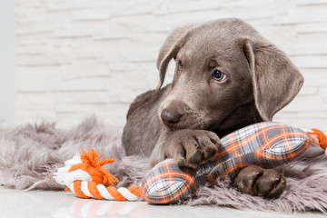
What is resource guarding
The dog might growl, stiffen, lunge or bite when you go near or try to retrieve something they deem valuable
Typically, dogs will resource guard toys, food, or bedding
Sometime stolen or found items are guarded like a dropped tissue, a granola bar wrapper, or sock
It is a common dog behaviour, but can also escalate over time
Never push a resource guarding dog past his threshold

Slide 3
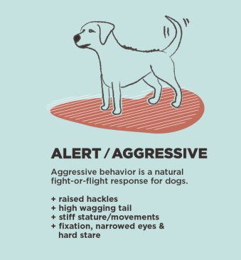
Body language to watch for

Slide 4
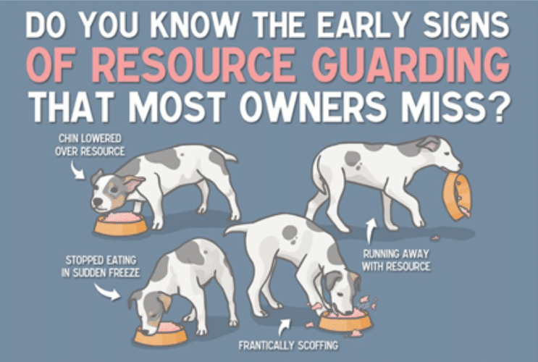
Signs to watch for
Eating even faster when people approach
Hunching over item
Stiffening when people approach dog when dog has item
Looking up with a hard stare
Hunching over item and growling

Slide 5
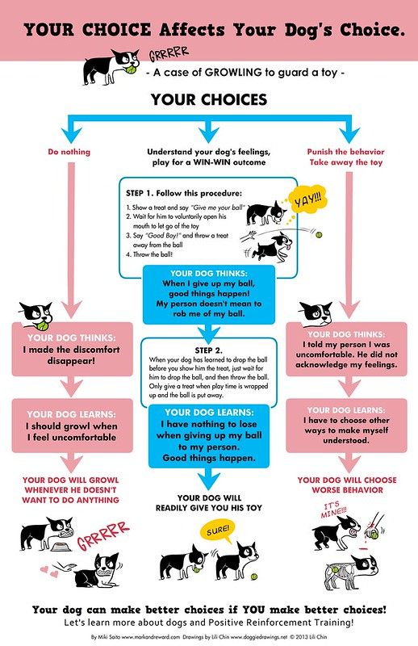

Slide 6
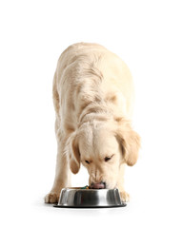
What to do
Hand feed dog a few meals each week
Add more kibble to the bowl while it is on the floor
Trade: It is important that when something is taken from dog, that an item of equal or high value replaces it
If in a multi dog home, give dog a safe place to eat i.e. their crate

Slide 7
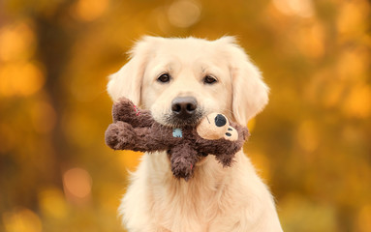
What not to do
Do not punish dog for growling or reacting negatively
  Instead give dog space to calm down
Do not play with dog’s food
  Instead allow dog to eat in peace
Do not put hand in dog’s food bowl
  Instead be around dog while he eats at a distance
Do not leave toys or chews out that dog will guard
  Instead manage dog’s time with toys or chews

