Slide 1

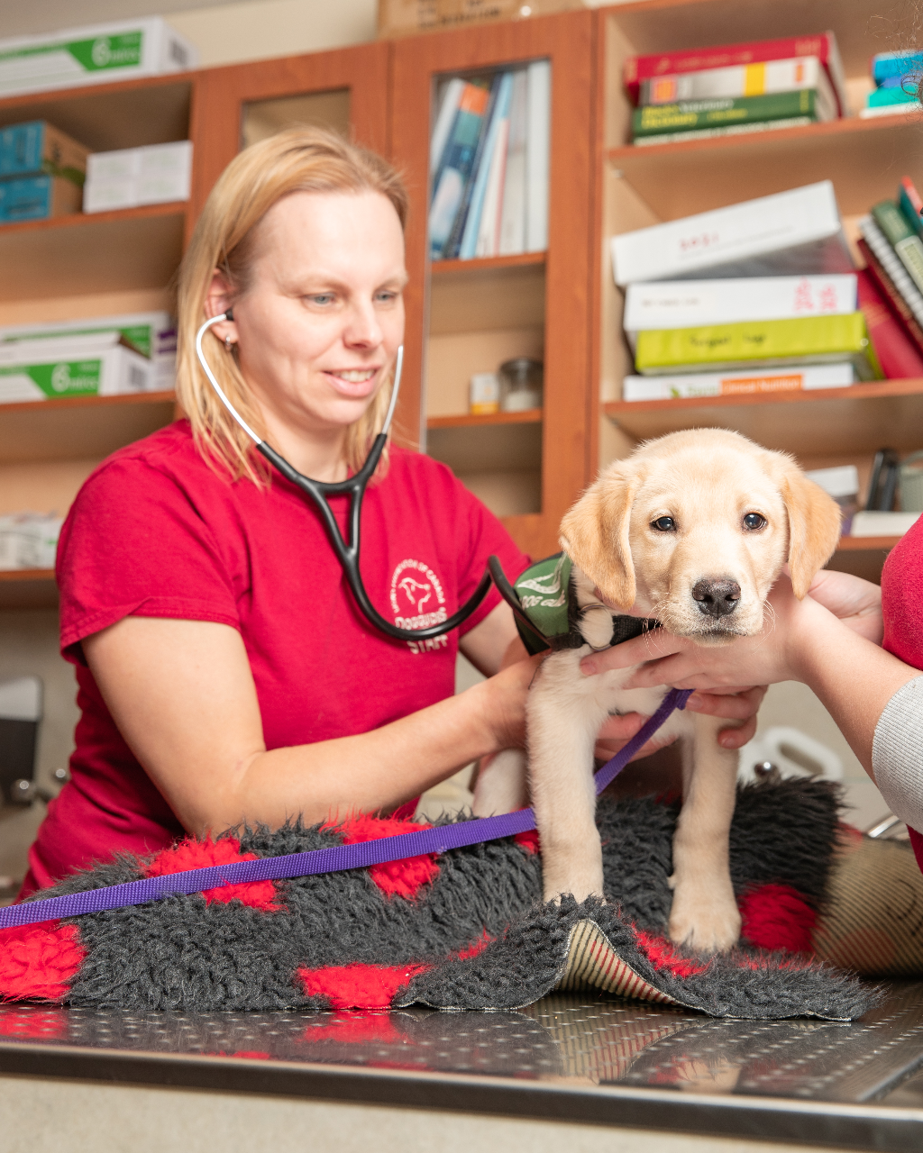
Vet Clinic Manners Overview
When Puppy Arrives
Time to get Weighed
Treats During the Appointment
Exam
Treatment

Slide 2
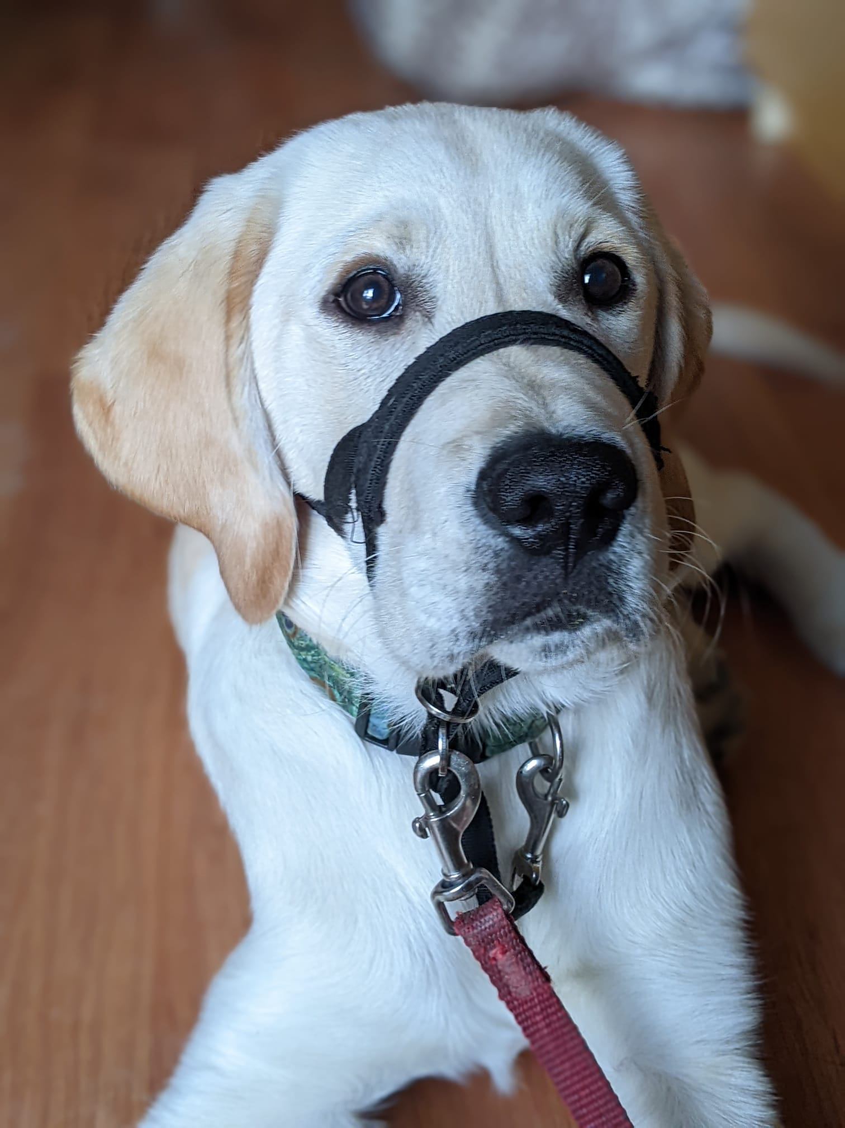
When Puppy Arrives
Puppy should be walking nicely on leash
Try to minimize pulling on leash
Puppy should be arriving with leash, collar, and head halter (after head halter has been introduced)
Puppy does not need to be in jacket for vet appointments
All four feet on the ground on meeting and approach of clinic staff
Try to minimize jumping up on staff

Slide 3
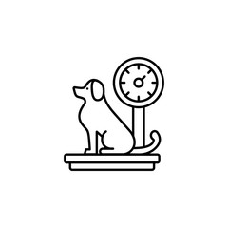
Time to get Weighed
Puppy will need to get weighed on a scale at the start of their appointment
Puppy needs to sit calmly on scale to be weighed
Sitting still on the scale is required so we get a proper weight
Waiting for release of the sitting position before puppy gets off the scale is also important, so puppy does not get up before the weight is registered

Slide 4
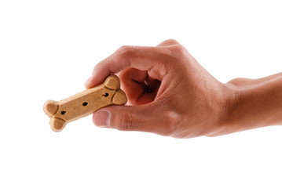
Treats During the Appointment
Depending on the appointment type, puppy may be given treats throughout their appointment
Taking treats gently is very important
Being nervous or anxious in the vet clinic can cause puppy to take treats roughly
Ensure puppy can take treats gently in different environments from a variety of people

Slide 5
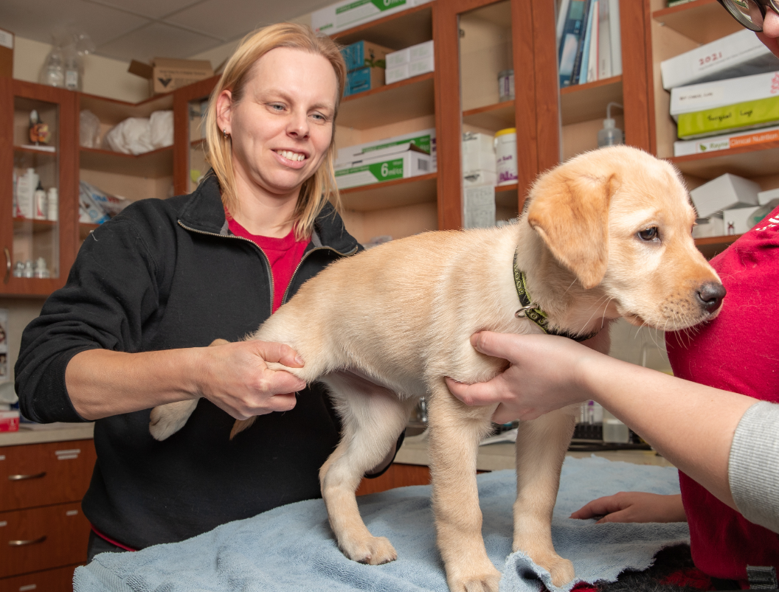
Exam
Puppy needs to be comfortable with handling for exam
We want to make sure puppy does not hide in corner of the room or at the door
We do not want puppy to growl when approached by staff
Having different people handle puppy will encourage more confidence to be handled
Handling in different environments will also boost puppy’s comfort of being handled

Slide 6
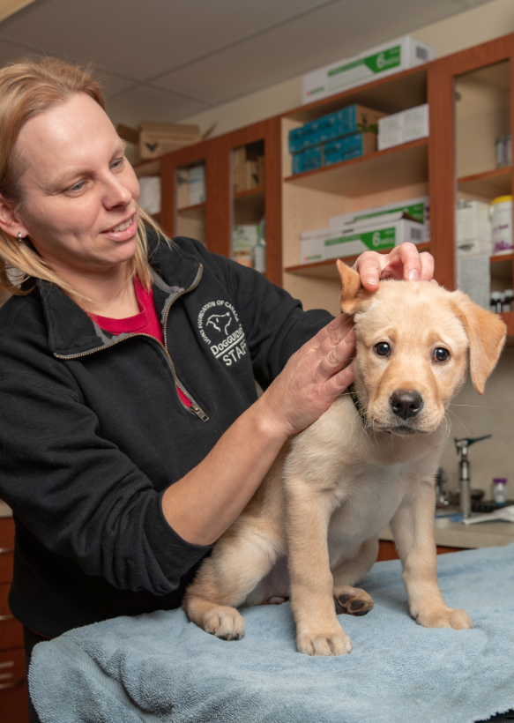
Treatment
Puppy needs to be comfortable with handling so treatment/medication administered
Handling can include touching ears, paws, eyes, mouth etc.
Standing still with all four paws on the ground in a settled/calm manner is needed when administering treatment/medication
Vet holds are important while treatment/medication administered
Practicing vet holds, handling and administering medications should be a regular part of puppy’s routine
Example: using an empty eye drop bottle to practice administering eye drops on puppy

